Slide 2
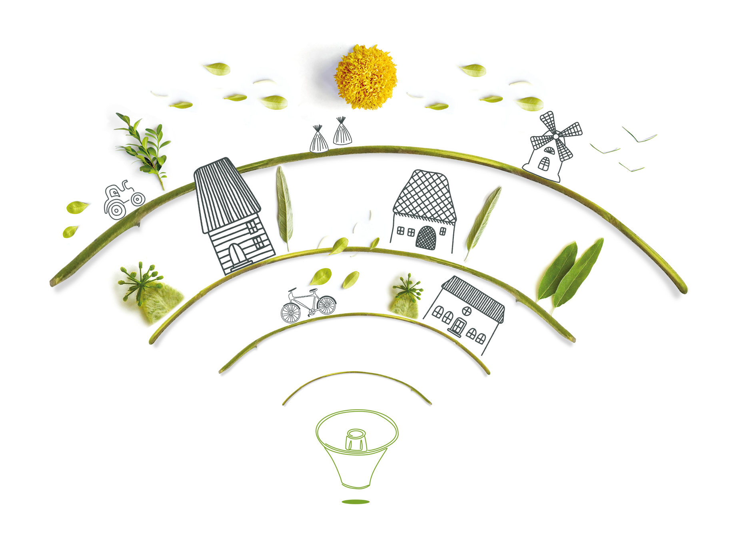
Help us design the transformational rural development policies of tomorrow
Nina Klein & Amelie Krug
ECOLISE – European network for community-led initiatives on climate change & sustainability

Slide 3
Three political demands for “A living European Green Deal”
What we think it takes to make transformational local/ bioregional development happen - with community-led initiatives (CLIs) at the heart
1. Why are changed human-nature relationships the basis for transformational change?

Slide 4
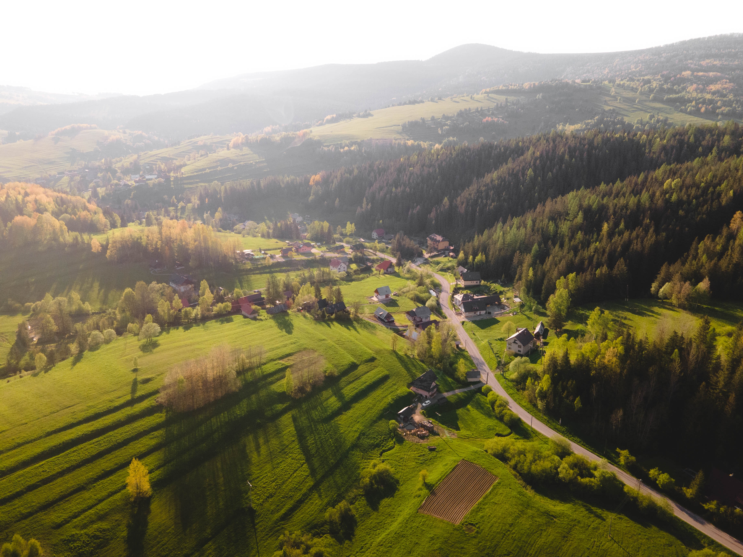
Rural areas as stewards of the earth
Planetary Health
Nature protection & conservation = basis for all human activities (social & economical & cultural), healthy planet = healthy human
Recognize rural areas as stewards of the land
Introduce alternative metrics for a wellbeing economy (instead of focussing on growth/ GDP)
Call to prioritise nature in all policies and localise the European Biodiversity strategy/ EU Nature Restoration Law with binding national, regional and local targets in line with the European Green Deal & provide adequate funding
→ include biodiversity mapping, monitoring into „Rural proofing” & the Rural Observatory

Slide 5
… Three political demands for “A living European Green Deal”
What we think it takes to make transformational local/ bioregional development happen - with community-led initiatives (CLIs) at the heart
2. Why do we need a strong connection between local / bioregional and European levels of governance?

Slide 6
Multi-level governance needed: Activate the potential of community-led initiatives
Inspiring radical lifestyle and social change
focus on demand-side factors in national contributions towards the European Green Deal (especially: EU Climate Law, Nature Restoration Law, circular economy) & clear plans for localisation; focus on sufficiency
Bottom-up community-led initiatives need to be recognized as catalyzers of transformative change : support space for socio-ecological transformative innovation & shared visions
Stimulate bioregional approaches which take socio-ecological interdependencies as a measure for bioregional development plans

Slide 7
… Three political demands for “A living European Green Deal”
What we think it takes to make transformational local/ bioregional development happen - with community-led initiatives (CLIs) at the heart
3. Why is collective action led by communities so important?

Slide 8
Focus on collective and
systemic community-led action
Make use of existing methods and frameworks such as LEADER/ Community-led local development (CLLD) & scale tchem
Recognize the need for systemic change alongside individual change
Dedicate sufficient budget to this goal
reach out to communities, not only to citizens = strengthen initiatives such as the Rural Pact & EU Climate Pact
Capacity building for healthy communities = knowledge/ education, sharing of good practices etc.
Notes:
Systemic change: targeting all human activities (sectors), but also culture/ worldview (attitudes and mindsets at the root of externalised systems); see the planetary crisis as interconnected (no siloeing between “climate” and “biodiversity”), acknowledge interdepences between nature and human systems
8% of EU budget for LEADER / CLLD

Slide 9
Thank you for your attention!
Join the conversation about transformational
community-led development policies:
Kick-off date for the presentation of Ecolise’s 10 theses:
28 September 3-5 pm CET online
Main policy stakeholder event:
28 November 2-5 pm CET onine
Nina Klein, Policy Lead
Nina.klein@ecolise.eu
Amelie Krug
Amelie.krug@ecolise.eu

