Slide 2
Messages from Gathering participants
Time to react?

Slide 3
Local matters
Eleanor Roosevelt – First Lady in the US 1933-1945
“Where, after all, do universal human rights begin? In small places, close to home—so close and so small that they cannot be seen on any map of the world. Yet they are the world of the individual person: the neighborhood he lives in; the school or college he attends; the factory, farm or office where he works. Such are the places where every man, woman, and child seeks equal justice, equal opportunity, equal dignity without discrimination. Unless these rights have meaning there, they have little meaning anywhere. Without concerted citizen action to uphold them close to home, we shall look in vain for progress in the larger world”.

Slide 4
Andrés Rodríguez-Pose: The revenge of the places that don’t matter (and what to do about it) 2018
“Persistent poverty, economic decay and lack of opportunities are at the root of considerable discontent in declining and lagging-behind areas the world over. Poor development prospects and an increasing belief that these places have “no future”—as economic dynamism has been posited to be increasingly dependent on agglomeration economies—have led many of these so-called “places that don’t matter” to revolt against the status quo. The revolt has come via an unexpected source: the ballot-box, in a wave of political populism with strong territorial, rather than social foundations. I will argue that the populist wave is challenging the sources of existing well-being in both the less-dynamic and the more prosperous areas and that better, rather than more, place-sensitive territorial development policies are needed in order to find a solution to the problem. Place-sensitive development policies need, however, to stay clear of the welfare, income support and big investment projects of past development strategies if they are to be successful and focus on tapping into untapped potential and on providing opportunities to those people living in the places that “don’t matter”.

Slide 5
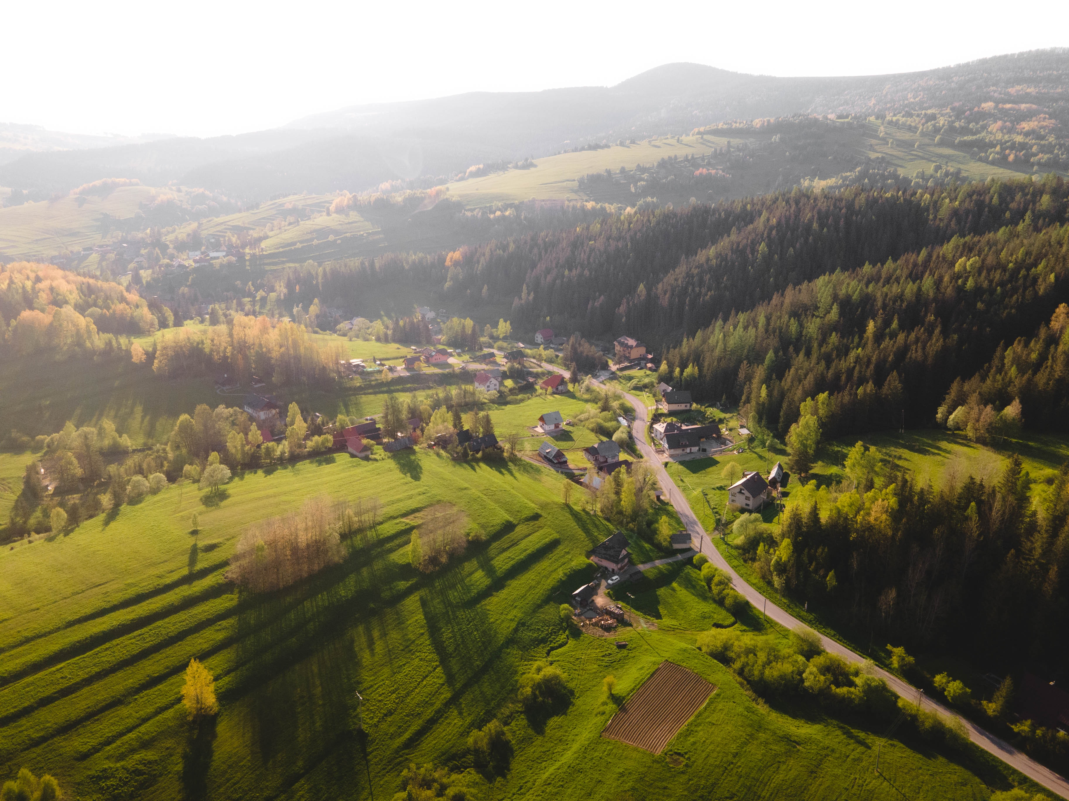
Navi" Pillay United Nations High Commissioner for Human Rights 2008-2014:
“...United Nations human rights mechanisms and voices from civil society were… reporting on exclusion, the marginalization of communities, discrimination, absence of participation, censorship, political repression or lack of an independent judiciary and denial of basic economic and social rights”.

Slide 6
Meeting challenges
Climate change is happening. Global warming, extreme weather, drought and inondation affect people, food security and in general livelihood options.
Biodiversity is declining faster than ever having an impact on ecosystems, food and water supply security. Water resources, their use and sufficiency are already creating conflicts from local to international level. The effects will be unequal.
In some parts land becomes less fertile and is losing in value, fisheries may or will decline. Poorer areas may not have resources to adapt themselves. Survival and economic migration will increase. Local, regional, national and international conflicts are to be expected.

Slide 7
“Farmland values are projected to decrease in parts of southern Europe by more than 80 % by 2100, which could result in land abandonment. Trade patterns are also impacted, which in turn affects agricultural income. While food security is not under threat in the EU, increased food demand worldwide could exert pressure on food prices in the coming decades” Climate change threatens future of farming in Europe — European Environment Agency (europa.eu)
According to the OECD in Europe “rural regions cover 80% of the territory and are home to approximately 30% of the population (OECD, 2020[1]). Climate change policies are often spatially blind, targeted to specific sectors or apply uniformly within countries, raising risks of policy fragmentation and sub-optimal outcomes. This can lead to ineffective use of public funds and trade-offs between climate change mitigation and other policy goals”

Slide 8
Looking to the future
Preventive and reactive actions
Capacity building
Partnerships and cooperation
Villages, communities and functional territories as partners and economic actors
Local economy
Appropriate support schemes
Social capital

Slide 10
The warmest thanks for the participants of the Gathering

