Slide 2
Peripheral …Rural….holds the keys to the future!
Theona L Morrison

Slide 3
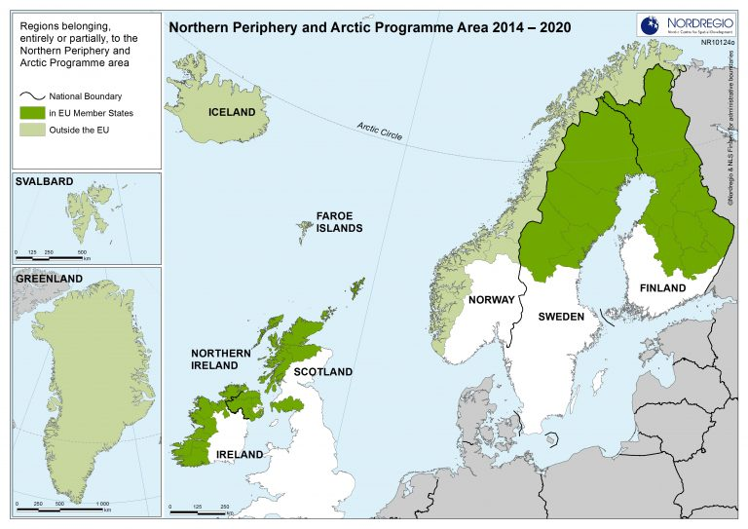
Evidence
Peripheral areas in the Northern Periphery and Arctic countries
“Peripheral areas demonstrated remarkable resilience during the pandemic and, on balance performed relatively well during Covid-19, even though many did not have a fully developed health infrastructure.”
Notes:
During the pandemic and drawing on research from across the NPA Ireland and the Highlands & Islands of Scotland

Slide 4
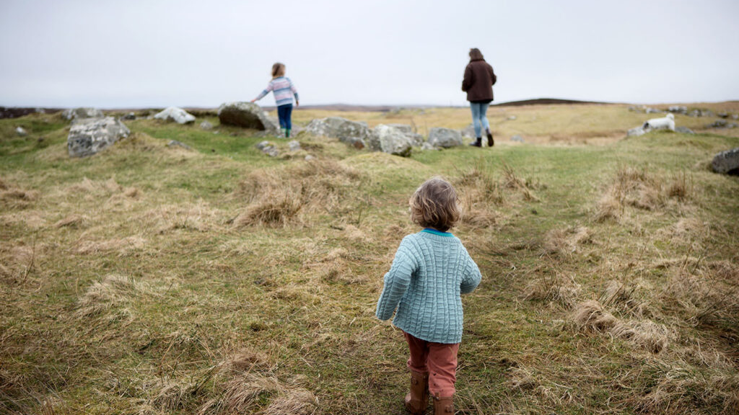
Influencing factors:
Low population density
Community cohesion
Rapid community engagement and participation
Local solutions

Slide 5
You never change things by fighting the existing reality. To change something, build a new model that makes the existing model obsolete.
R. Buckminster Fuller
What can ERP deliver?
What can we contribute to ERP?
What should be the main focus 2022-2024?

