Slide 2
Social entrepreneurship
Magdaléna Čurillová
OZ VIPA SK (Rural parliament in Slovakia)

Slide 3
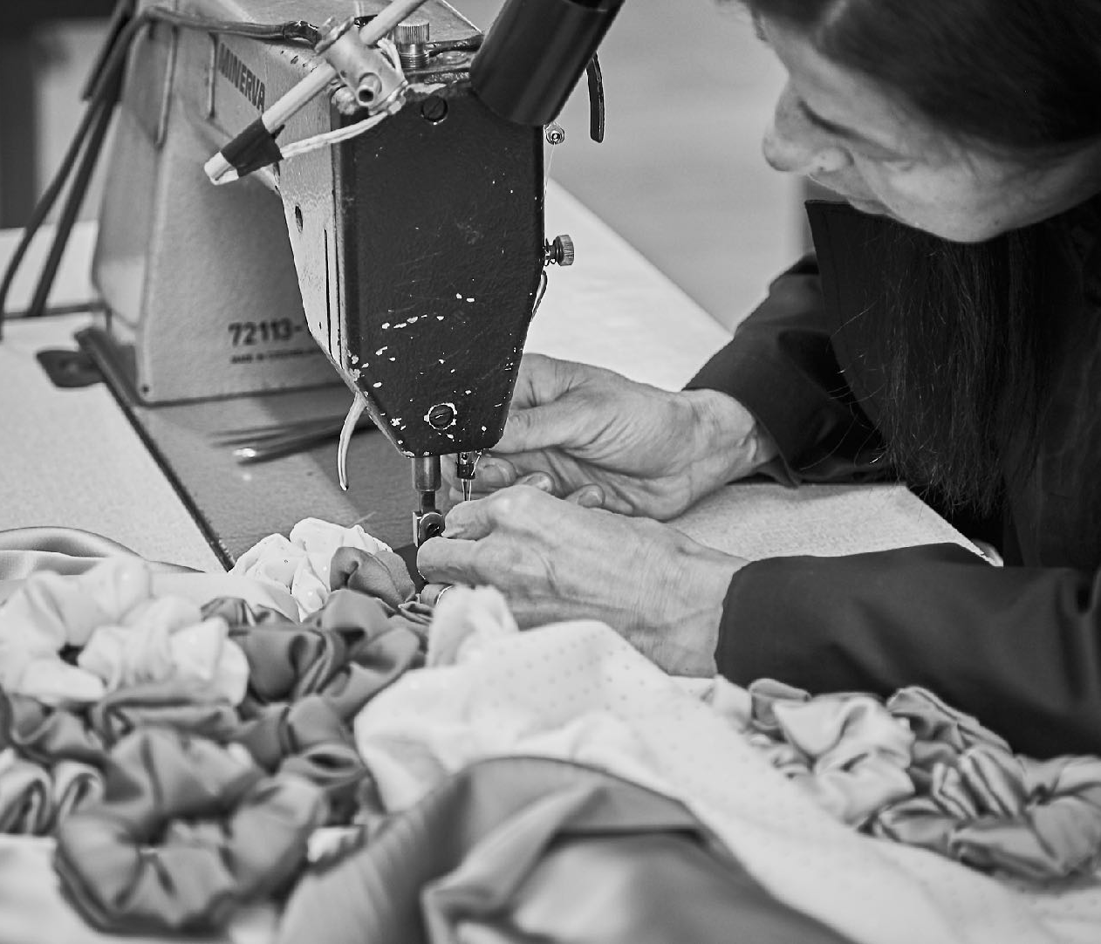
Slovakia has the lowest female employment rate in Central and Eastern Europe (59.3%). This problem is even more pronounced in economically backward regions. It is particularly difficult for these groups of women to find work:
Single mothers
Women with lower education
Women with disabilities and poor health
Women 50+
Roma minority

Slide 4
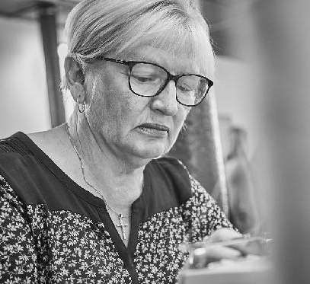
Key steps to functioning
Decreasing barrier
Increasing cohesivness/social cohesion
Stimulation
Strategies
Burning people with creative thinking and realizing ideas
House for cats and dogs – working with Freedom of animals organisation and WOLT slovakia, made by our women over 60 years

Slide 5
A business founded to provide tailor-made jobs for long-term unemployed women. A functional model that will help the unemployed escape the poverty trap and find a job that suits their specific needs (flexible working hours, low qualifications, social skills).The goal of the company is not to make a profit, but to socially and economically strengthen people in a difficult life situation, increase their qualifications and renew work habits.

Slide 6
WHAT IS IMPORTANT
First of all I ask myself a question...Why do I want to start a social enterprise?
To what extent it will be effective, we must follow the goal of the company
The most important fact is A project built on ideas and ambitions
It is important to realize that social entrepreneurship should be treated as a business. The business must support itself, at the same time bring a better life to people, and what it receives from the state is just a kind of bonus.

Slide 7
Social entrepreneurship has great prospects now and in the future for the employability of highly unemployable people. Every municipality, city, region, person can establish such a social enterprise, which will gain support from the state and the European Union. In Slovakia, by 2018 the State helps social enterprises by providing financial support for employing people up to 75% of the total cost of work, provides financial support for the purchase of machines, devices, equipment, benefits in the field of public procurement and many others. Therefore, it is important to realize that social entrepreneurship can be a great benefit with a great impact on working with local people, for local people and with local resources. The goal is not only employment, but also job creation and being a positive role model in this area. The main aspect is employment, because it is impossible without it.

