Slide 2
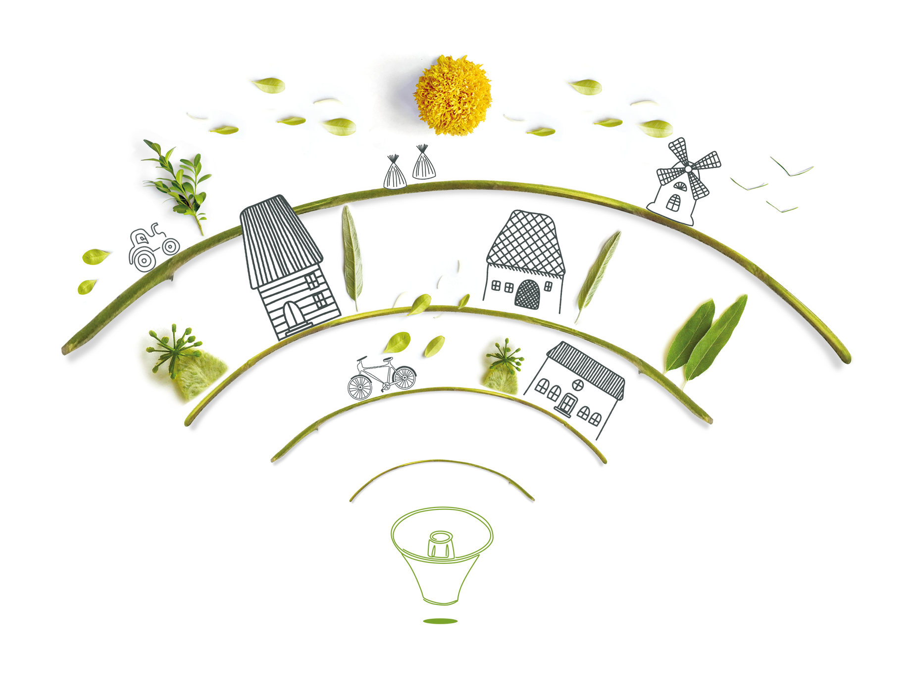
Depopulation in Spain: declining rural areas?
Irene Martín García
Spanish Network for Rural Development (REDR)

Slide 3
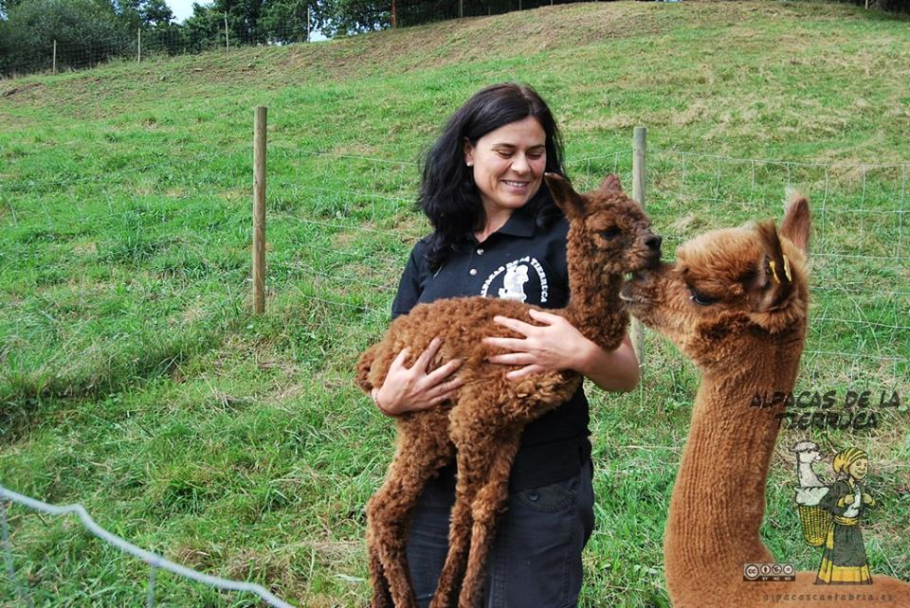
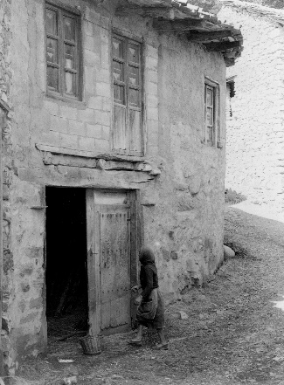
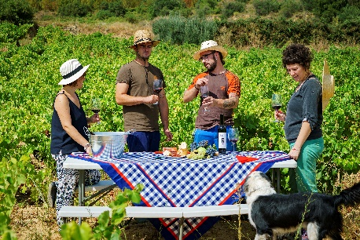
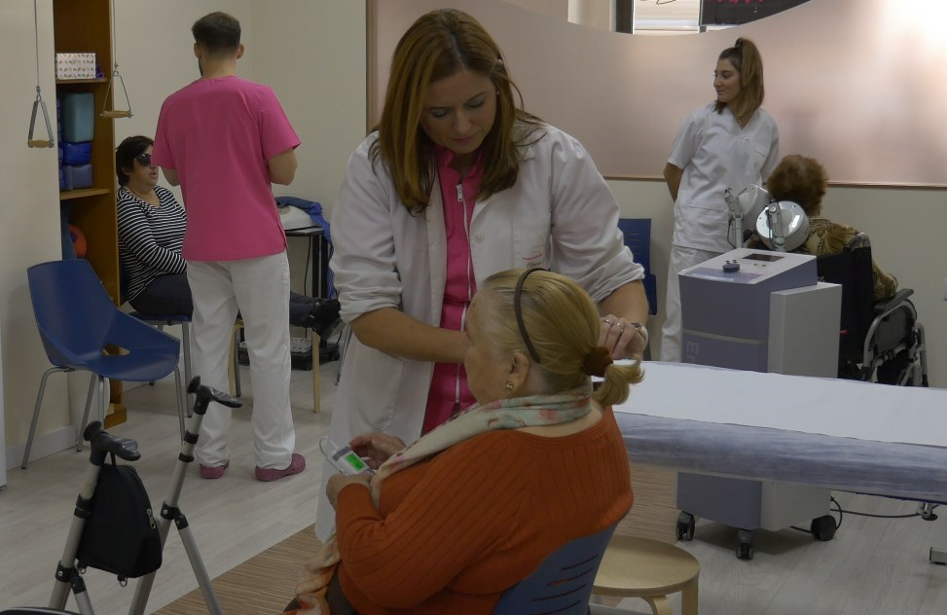
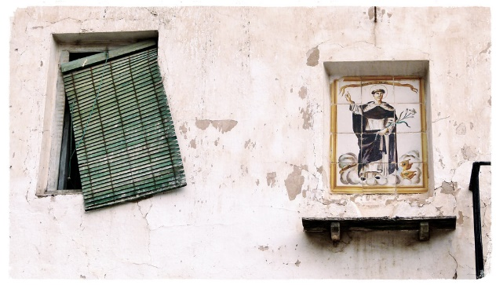
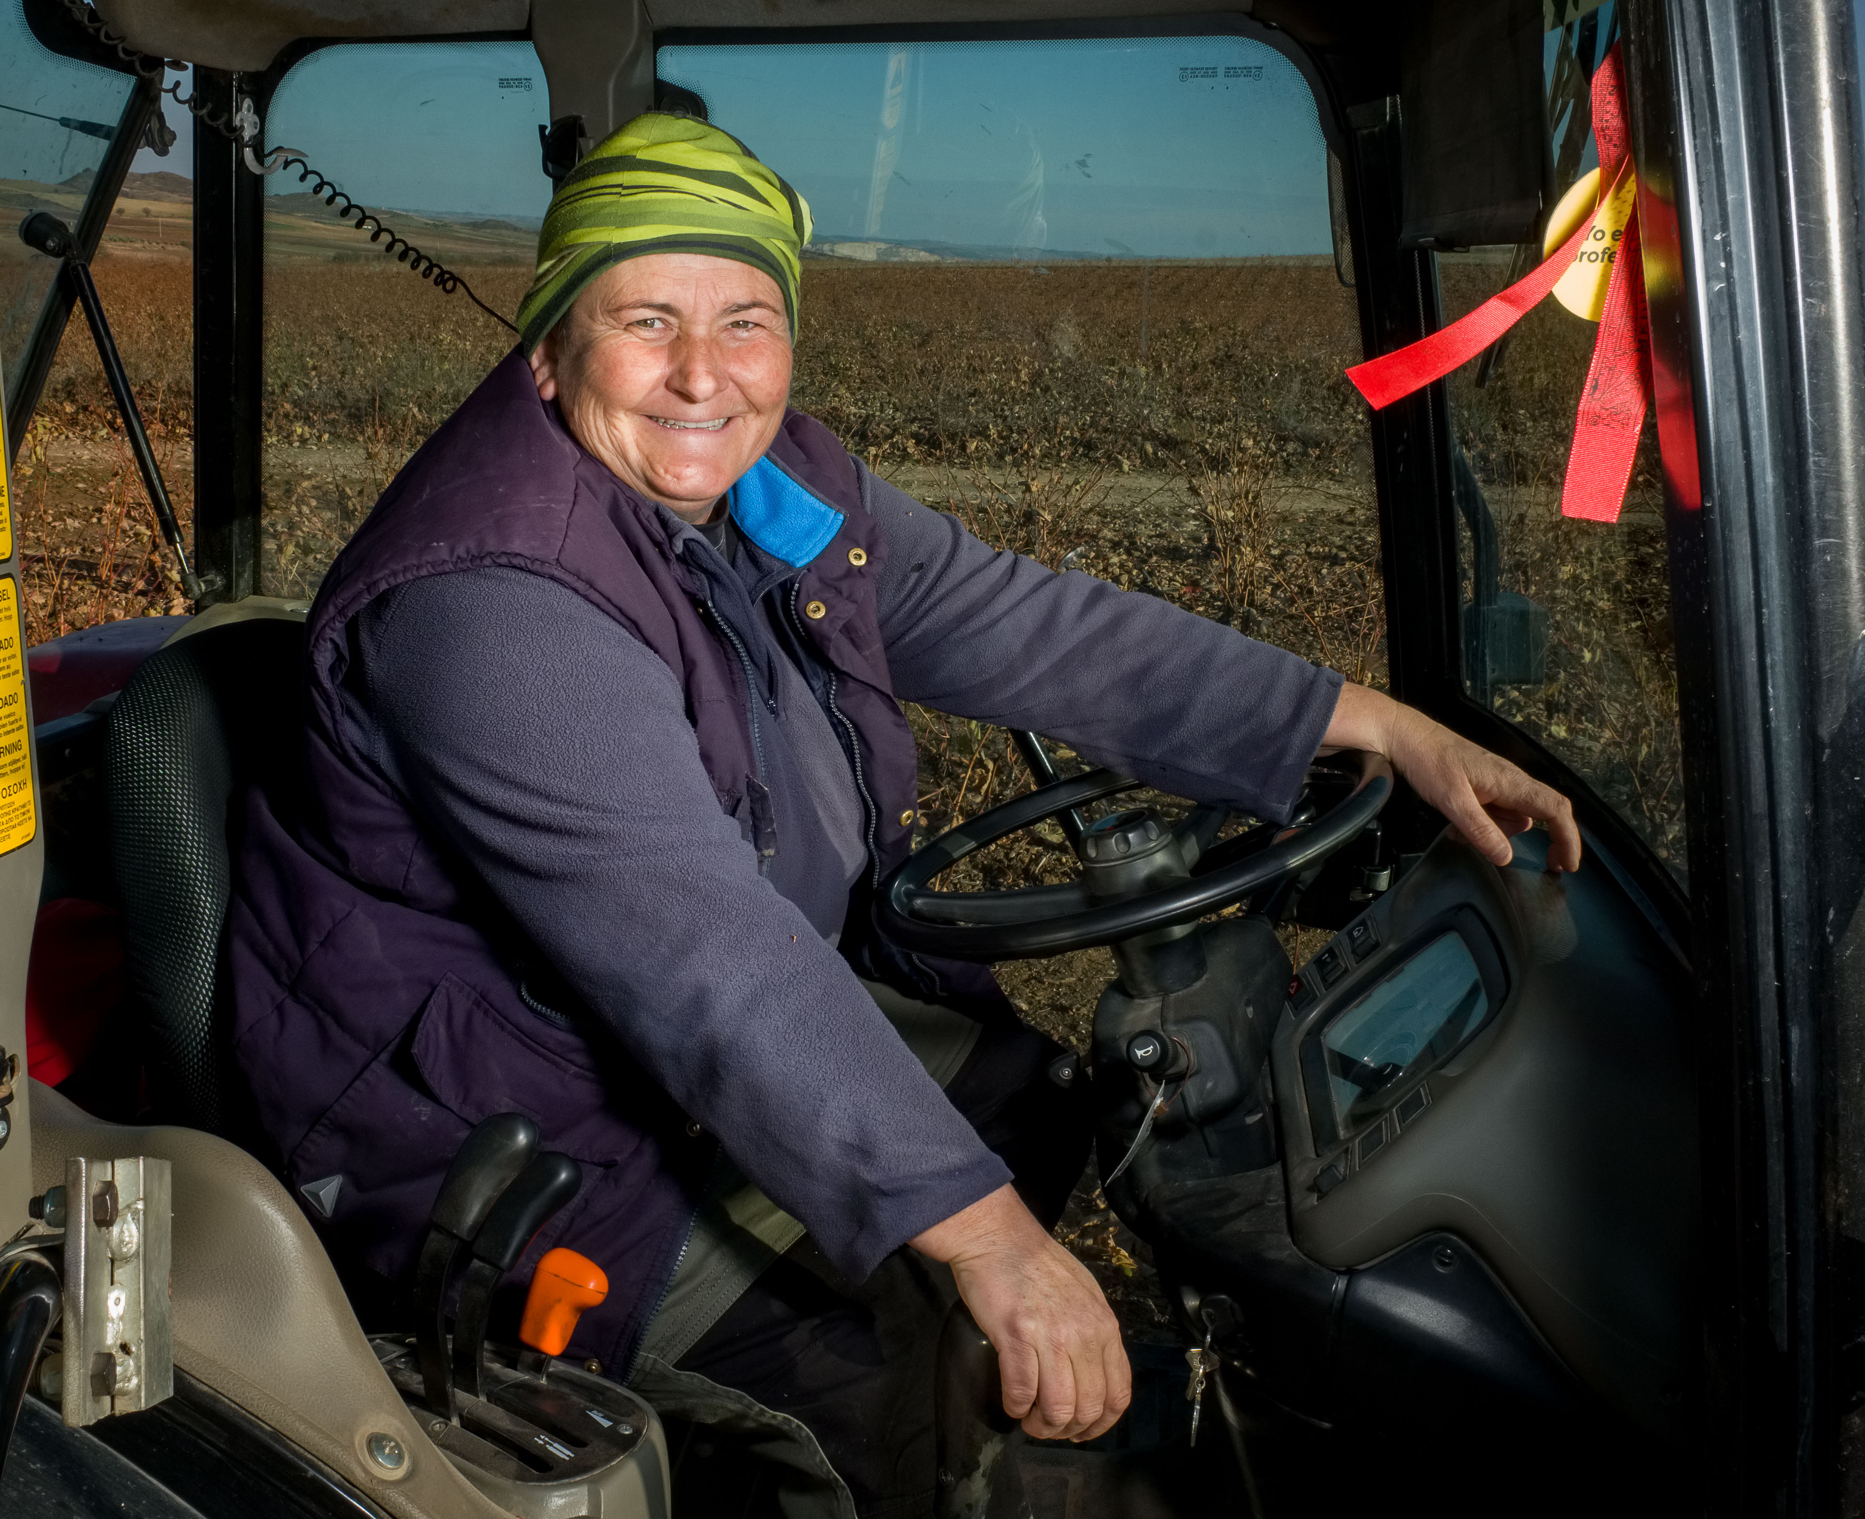
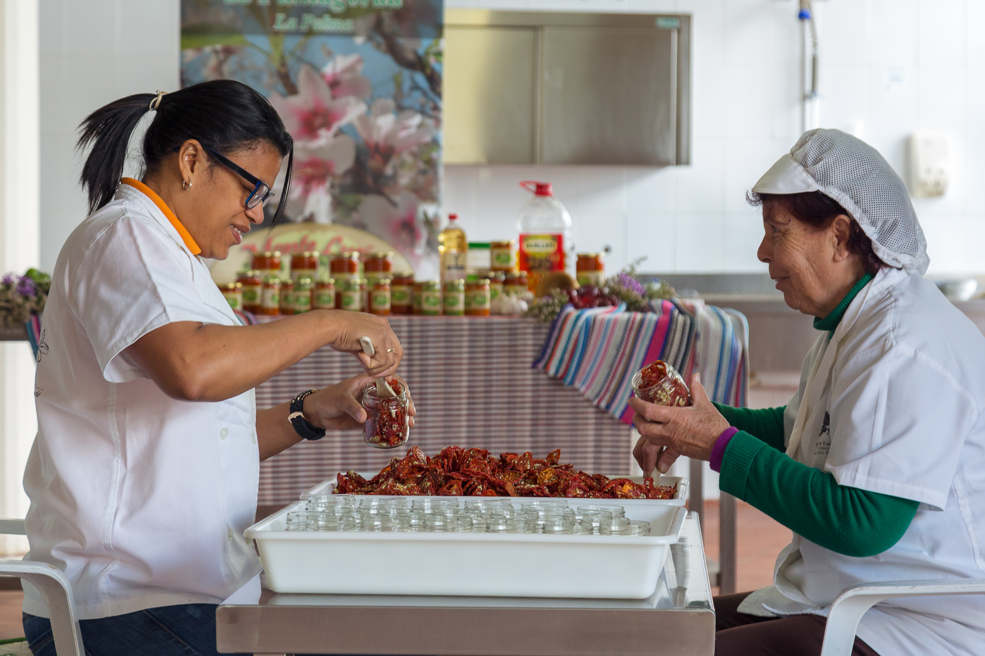
Declining rural areas? Importance of the story-telling

Slide 4
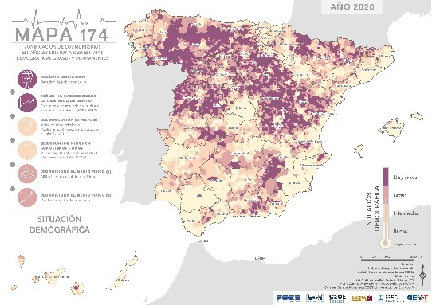
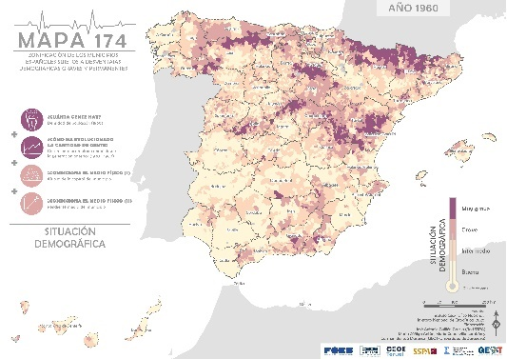
Depopulation trend in Spain. An homogenous trend?
1950
2020
Source: SSPA Map 174 (2020)

Slide 5
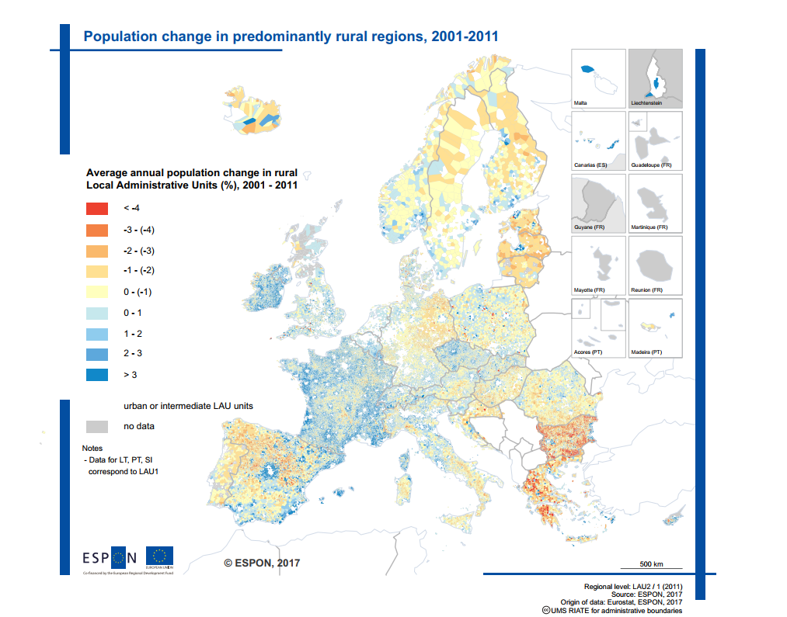
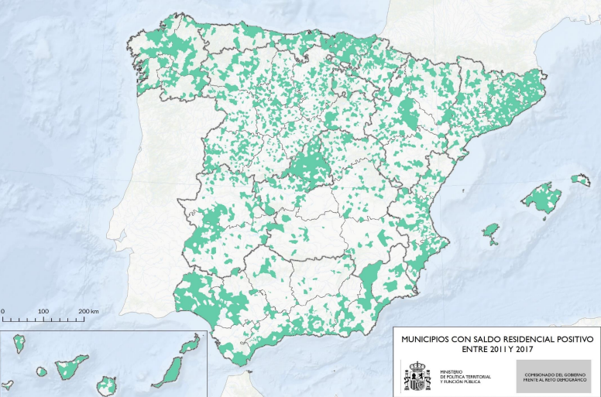
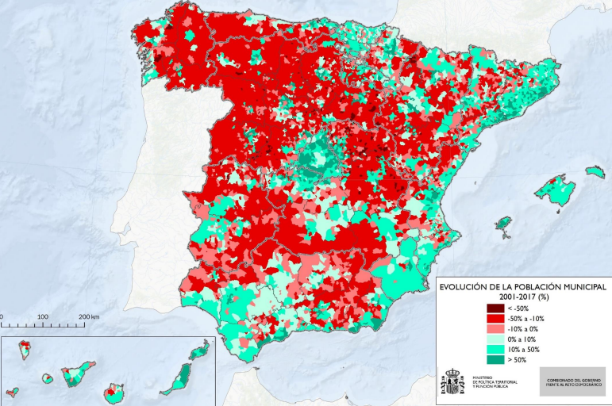
Depopulation trend in Spain. An homogenous trend?
Source: MITECO (2017)
Source: ESPON (2017)

Slide 6
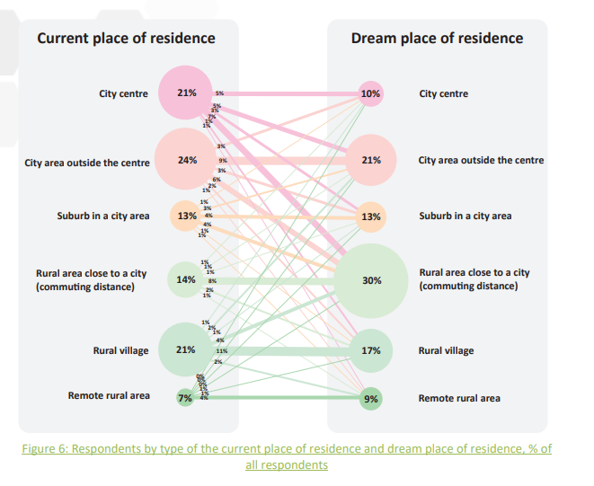
Depopulation trend in Spain. An homogenous trend?
DEPOPULATION
RETURNING
Those more isolated and smaller municipalities that, for geographical or other reasons, are disconnected from the new infrastructure and transport networks and urban centers, will probably continue to lose population and, in some very extreme cases, will end up becoming depopulated.
In short, it is likely that in 2050 fewer people will live in rural Spain than today. But, (…), those who do so could live better than now.
Source: Ruralization (2020)

Slide 7
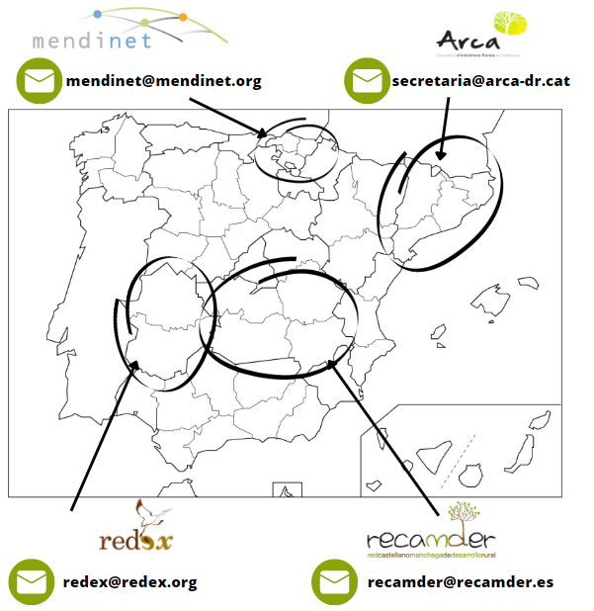
What and how do we do it?
DEPOPULATION
Cover those municipalities that are losing population. Accepting and mitigating the effects.
Rural Development must be a State matter.
Advocacy for Rural Agenda and Rural Proofing
Mainstreaming rural development in all Public Administrations

Slide 8
What and how do we do it?
RETURNING
To maintain an promote the returning trend
Transforming our narrative
Amplifying our target: urban areas and rural areas are not in competition!
Listening to the people to want to stay or come back and creating new opportunities for them to be able to do it.

Slide 9
Thank you!
redr@redr.es

